Slide 1




amazon. Product Data Analysis (2026)
Portfolio Project
Tools: MySQL, Python, Pandas, and Matplotlib form a powerful data analytics stack used to extract, process, and visualize relational data...
amazon.
End-to-End Data Analytics Portfolio Project
Prepared By
Jitendra More
Notes:
Good morning. My name is Jitendra More. Today I am presenting my Amazon Product Analysis project. I used Python, Pandas, MySQL, SQL, and Matplotlib to clean the data, calculate KPIs, create visualizations, and convert the results into business insights.

Slide 2

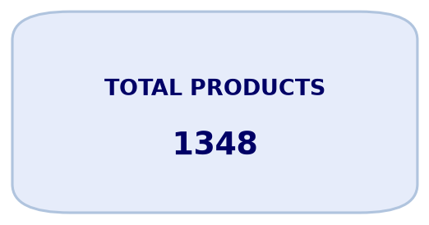
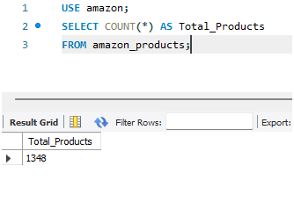
Total Products KPI
1,348 unique products remained after cleaning 1,465 raw records. Product ID was used as the unique key, preventing repeated listings from inflating the KPI.
Notes:
The raw dataset contained 1,465 rows and 1,351 unique product IDs. After handling missing or invalid values and keeping one record per product, the final dataset contained 1,348 unique products. I used product ID because product name alone is not a reliable unique key.

Slide 3
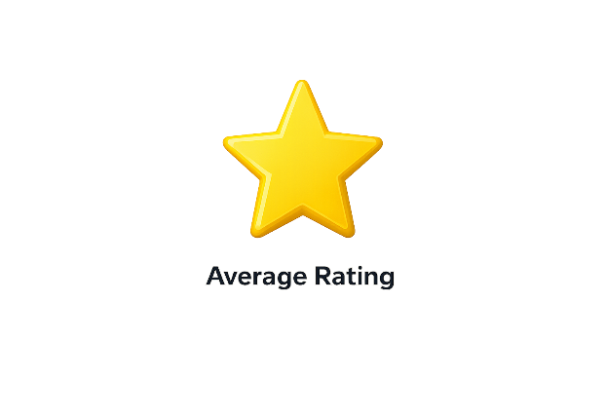
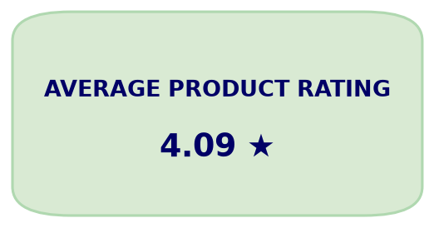
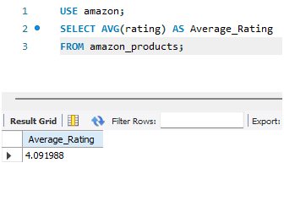
Average Product Rating
The average customer rating is 4.09 out of 5. Nearly 75% of products are rated 4.0 or higher, indicating generally positive customer satisfaction.
Notes:
The average product rating is 4.09 out of 5. Nearly 75 percent of products have ratings of four stars or higher, which indicates generally positive customer satisfaction. I also examined the distribution because an average alone does not show the complete picture.

Slide 4

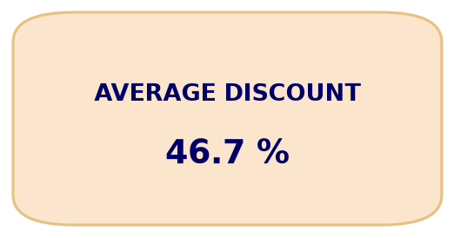
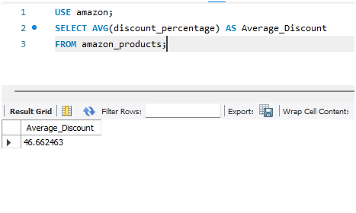
Average Discount
The average discount is 46.66%, displayed as 46.7% after rounding. Discounts are common, but they should be evaluated together with margin and customer response.
Notes:
The average discount is 46.66 percent, rounded to 46.7 percent in the presentation. This shows that promotional pricing is common. However, discount should be evaluated together with margin, demand, and customer satisfaction.

Slide 5

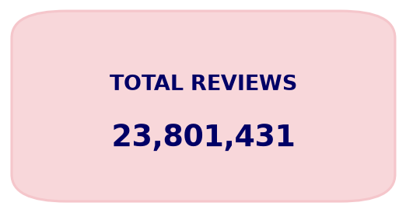
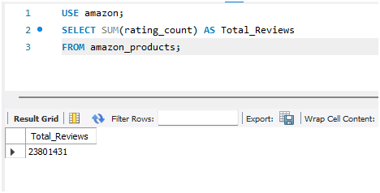
Total Reviews
The cleaned product dataset represents 23,801,431 customer reviews. Product-level cleaning was applied before aggregation to avoid inflated totals.
Notes:
After product-level cleaning, the dataset represents 23,801,431 customer reviews. I aggregated this only after checking repeated product IDs so the total would not be inflated.

Slide 6
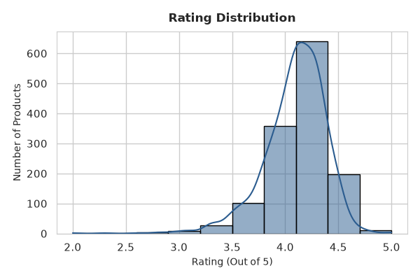
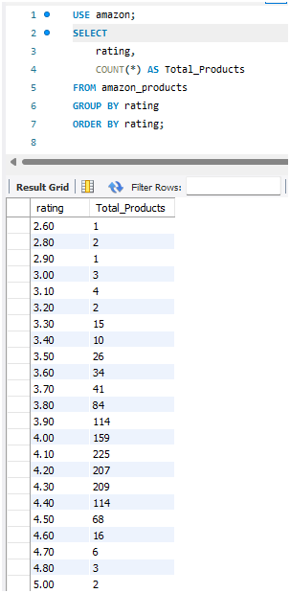
Rating Distribution
914 products fall between 4.0 and 4.4 stars. Overall, 1,009 of 1,348 products have ratings of 4.0 or higher.
SQL validates the exact values, while visualizations highlight overall patterns.
Most products are rated between 4.0 and 4.4, indicating strong customer satisfaction.
A majority of products fall within the 40%–79% discount range, showing aggressive promotional strategies.
Overall, the dataset reflects a high-performing product ecosystem with strong ratings and competitive pricing.
Notes:
This distribution shows that 914 products are rated between 4.0 and 4.4. In total, 1,009 of 1,348 products have a rating of four or higher. This supports the conclusion that ratings are generally positive.

Slide 7
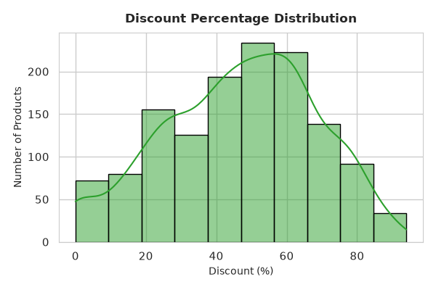
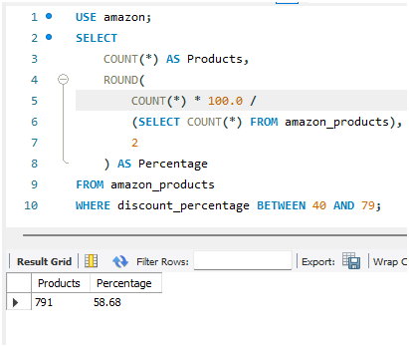
Discount Distribution
791 products, about 59% of the dataset, offer discounts between 40% and 79%. This indicates aggressive promotional pricing.
Notes:
This chart shows how discounts are distributed. About 59 percent of products offer discounts between 40 and 79 percent. Large discounts are common, but the business should confirm whether they improve demand without reducing profitability too much.

Slide 8
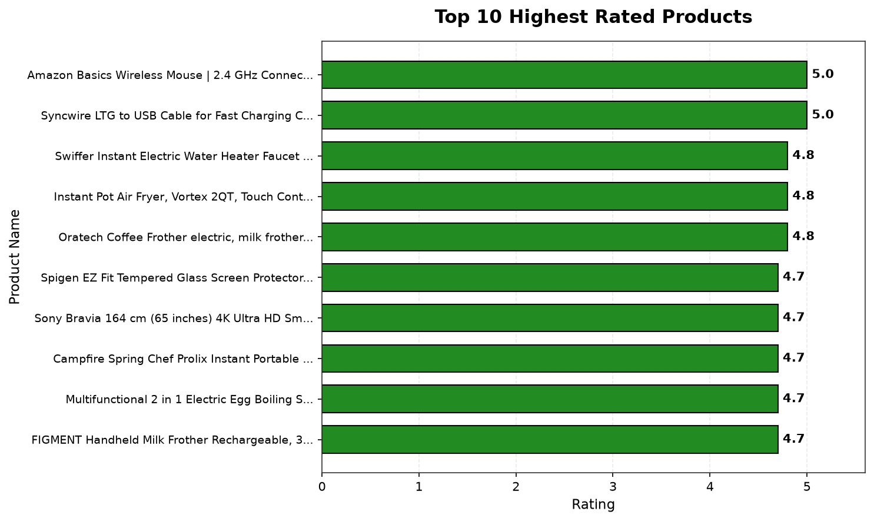
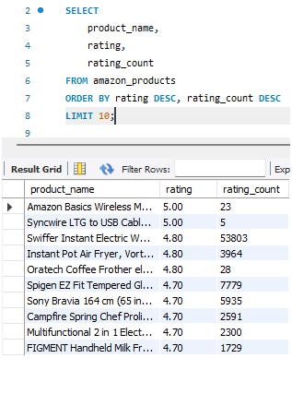
Top 10 Highest Rated Products
The leading products are rated between 4.7 and 5.0. Rating count should also be used as a tie-breaker because ratings supported by more reviews are more reliable.
“Products are ranked based on rating, and in case of equal ratings, review count is used to ensure more reliable results.”
Notes:
The highest-rated products range from 4.7 to 5.0 stars. When products have the same rating, I would use review count as a tie-breaker because a rating supported by more reviews is more reliable.

Slide 9
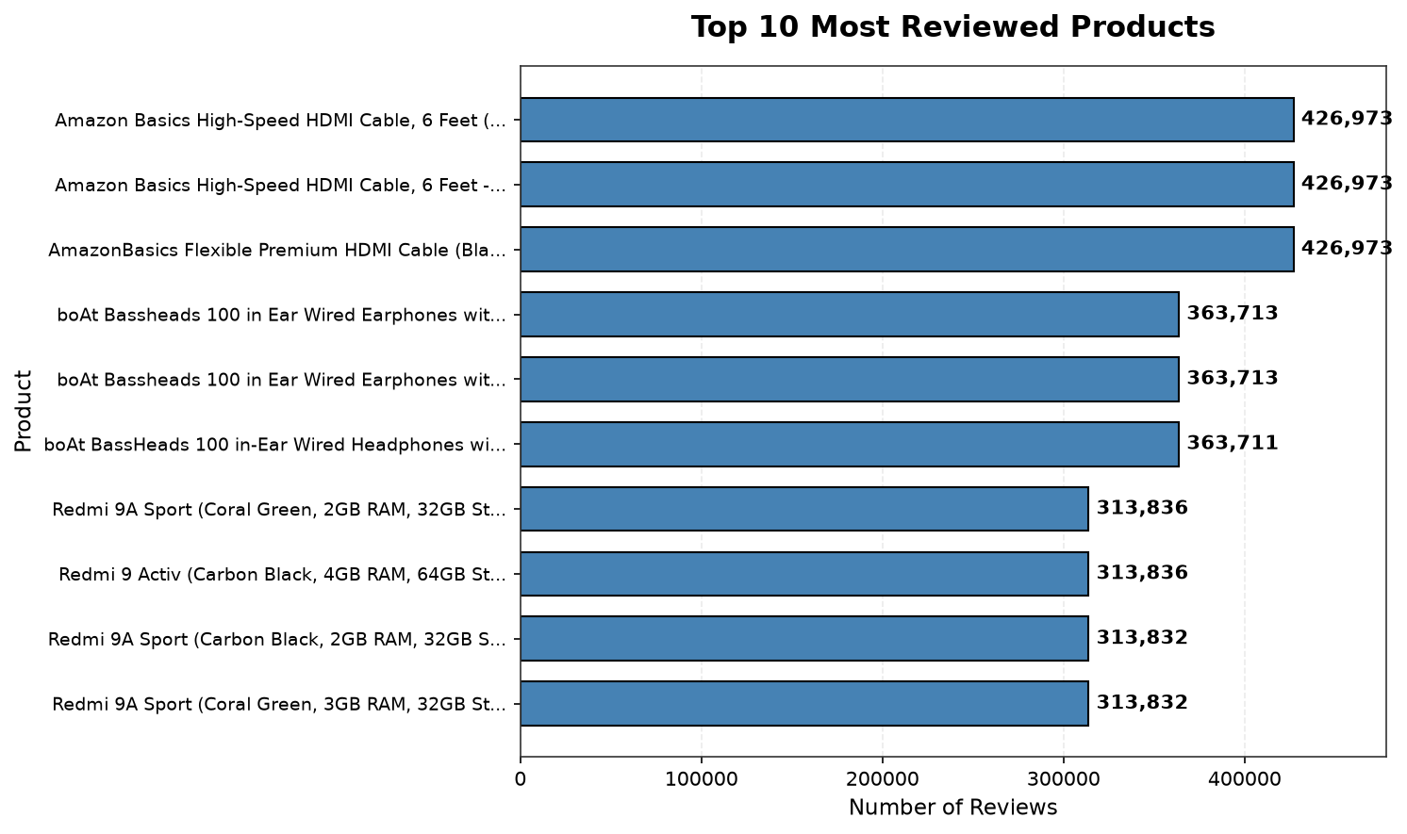
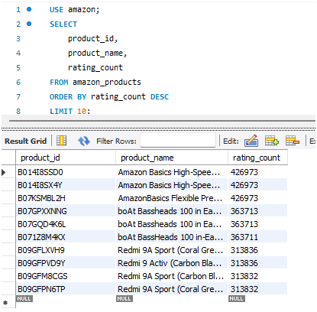
Top 10 Most Reviewed Products
Amazon Basics HDMI cable variants lead with 426,973 reviews. Similar names in the chart represent different product IDs or variants, not duplicate records.
The most reviewed products indicate high customer engagement and market demand.
Amazon Basics HDMI cable variants lead with the highest number of reviews, reflecting strong product popularity.
Similar product names represent different variants or product IDs, not duplicate entries.
Notes:
Amazon Basics HDMI cable variants have the highest review count at 426,973. Similar names appear because the records have different product IDs and may represent different variants. They are not duplicate product IDs.

Slide 10
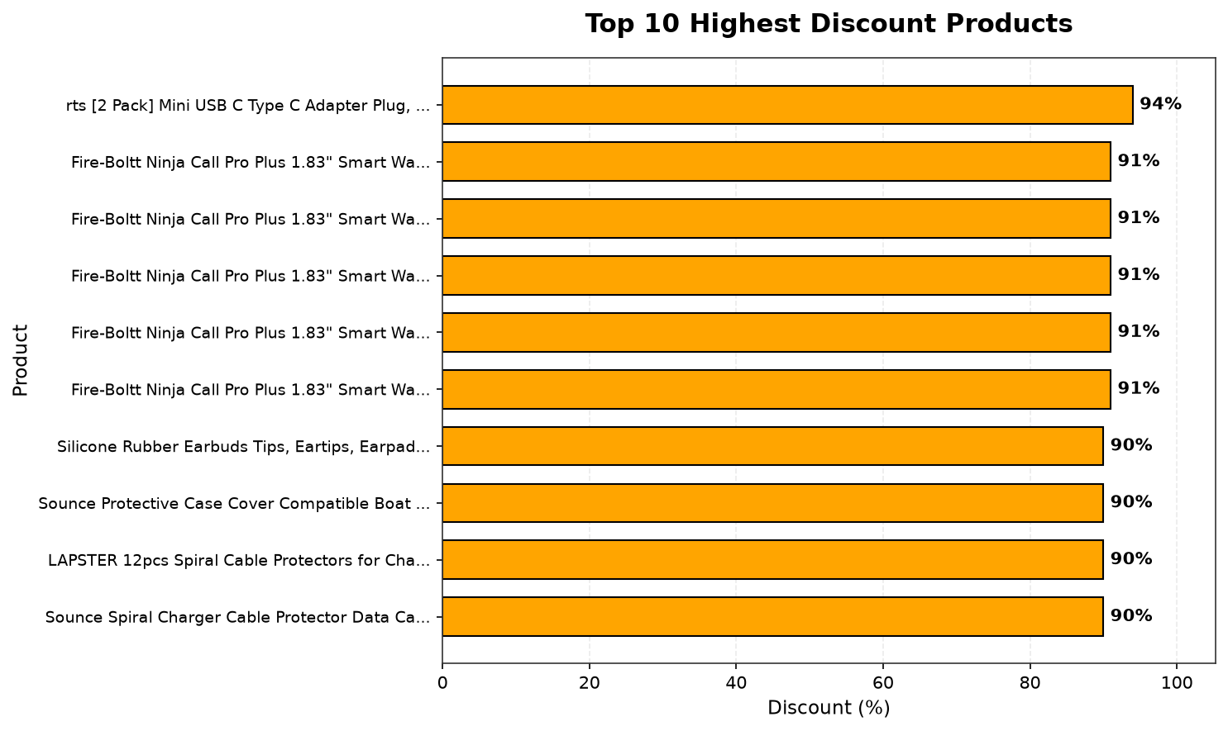
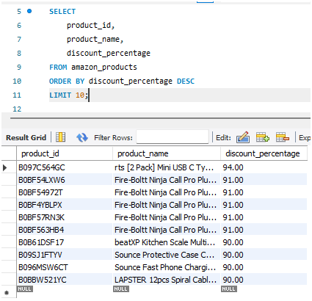
Top 10 Highest Discount Products
The highest discounted products range between 90% and 94%, indicating strong promotional activity.
Such extreme discounts suggest strategies like inventory clearance, customer attraction, or competitive pricing in the market.
Notes:
The highest discount is 94 percent, and several products offer discounts above 90 percent. These extreme values may reflect promotional campaigns, inventory clearance, or product lifecycle decisions, so profitability should also be reviewed.

Slide 11
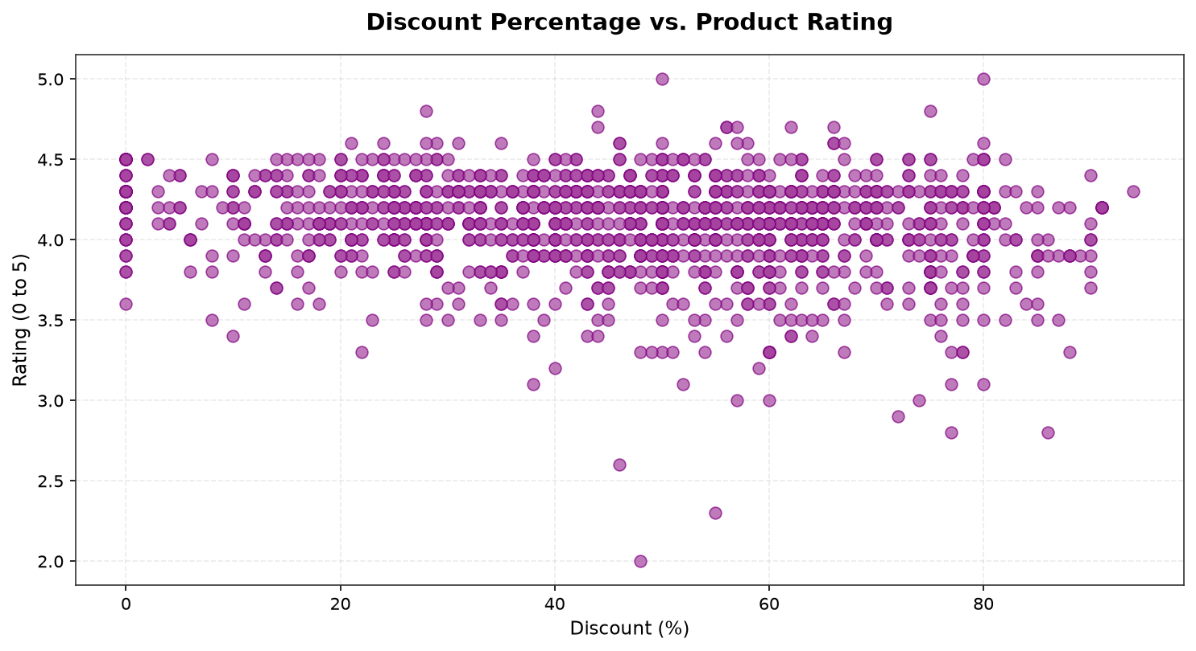
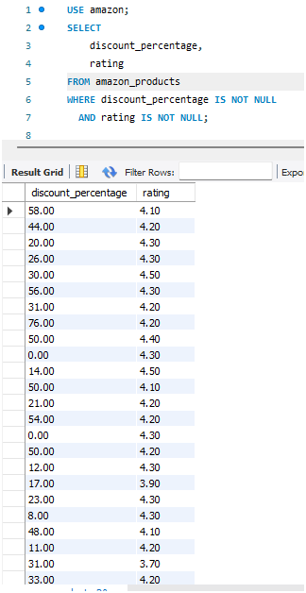
Discount vs Rating Analysis
The scatter plot shows no strong relationship between discount and rating. Higher discounts do not necessarily produce higher customer satisfaction.
Higher discounts do not guarantee higher ratings
Discount and rating are not strongly related — product quality matters more than pricing.
Notes:
The scatter plot shows no strong relationship between discount percentage and rating. This suggests that increasing a discount does not automatically increase customer satisfaction. Product quality and customer experience are likely more important.

Slide 12
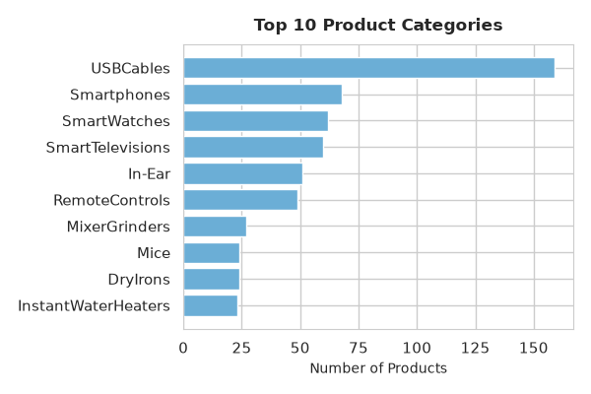
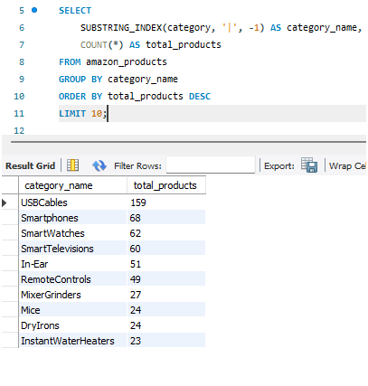
Top 10 Product Categories
USB Cables lead with 159 products, more than twice the 68 Smartphones. Computer accessories have the strongest representation in this dataset.
USB Cables lead with 159 products, showing strong dominance in the accessories segment.
Notes:
USB Cables form the largest category with 159 products, followed by Smartphones with 68 and Smartwatches with 62. This measures product assortment, not sales or revenue, because the dataset does not contain quantity sold.

Slide 13
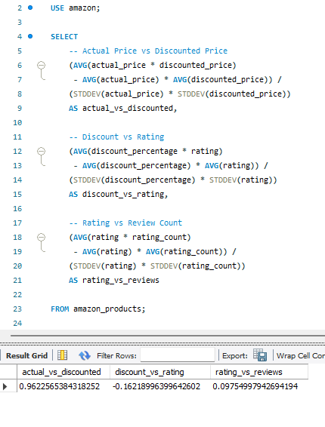
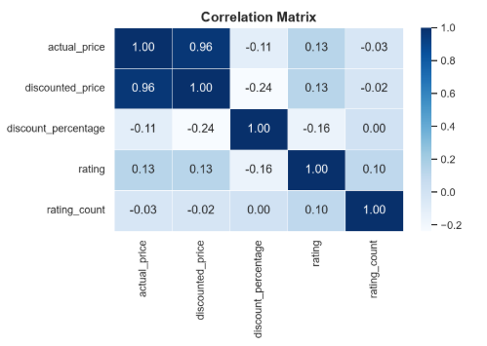
Correlation Matrix
Actual price and discounted price have a strong positive correlation of 0.96. Discount percentage and rating have only a weak negative relationship of -0.16.
Strong price correlation exists, but discount and ratings show weak relationships.
Notes:
The correlation matrix shows a strong positive correlation of 0.96 between actual price and discounted price. The relationship between discount percentage and rating is weak at minus 0.16. Correlation describes association and does not prove causation.

Slide 14
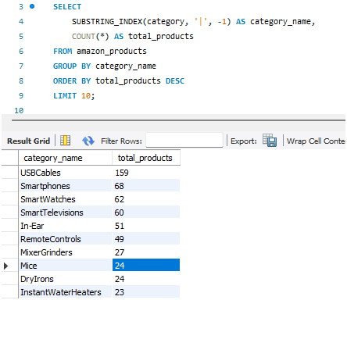
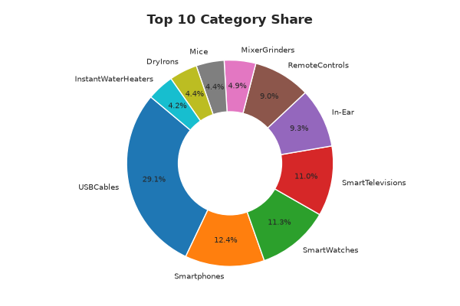
Top 10 Category Share
Within the Top 10 categories, USB Cables hold the largest share at 29.1%. These percentages do not represent the full Amazon marketplace.
👉 USB Cables share:
159 / 547 × 100 = 29.1%
SQL shows counts, while the chart shows percentage share based on total Top 10 categories.
Notes:
This chart shows the composition of only the Top 10 categories. USB Cables account for 29.1 percent within this selected group. These percentages should not be interpreted as the market share of the full Amazon marketplace.

Slide 15

Conclusion
Cleaned 1,465 raw records into 1,348 unique products.
Verified KPIs across Python and MySQL: 4.09 rating, 46.66% discount, and 23.8M reviews.
Found that nearly 75% of products are rated 4.0 or higher.
Observed that higher discounts do not necessarily improve ratings.
Recommendation: combine pricing strategy with product quality and customer experience.
Thankyou…..,
Notes:
To conclude, I completed an end-to-end analytics workflow using Python and MySQL. I cleaned the raw data, verified the KPIs in SQL, created visualizations, and translated the findings into business insights. My main recommendation is not to compete only through discounting. Product quality and customer experience should be part of the pricing strategy. Thank you. I am happy to answer questions.

